Slide 1


From Bias to Balance: A Data-Driven Approach to Fair Recruitment Practice
JSM 2025 Hairu Fan

Slide 2
From Bias to Balance: A Data-Driven Approach to Fair Recruitment Practices
Presenter
Hairu Fan, Ph.D. student, Department of Statistics, Actuarial and Data Sciences, Central Michigan University
Double Major: Applied Statistics & Business Information Systems
Email: fan2h@cmich.edu

Slide 3
Agenda
Introduction
Datasets & Data Preprocessing
Methods
Key Findings
Bias Analysis
Conclusion
From Bias to Balance: A Data-Driven Approach to Fair Recruitment Practices

Slide 4
Introduction

Slide 5
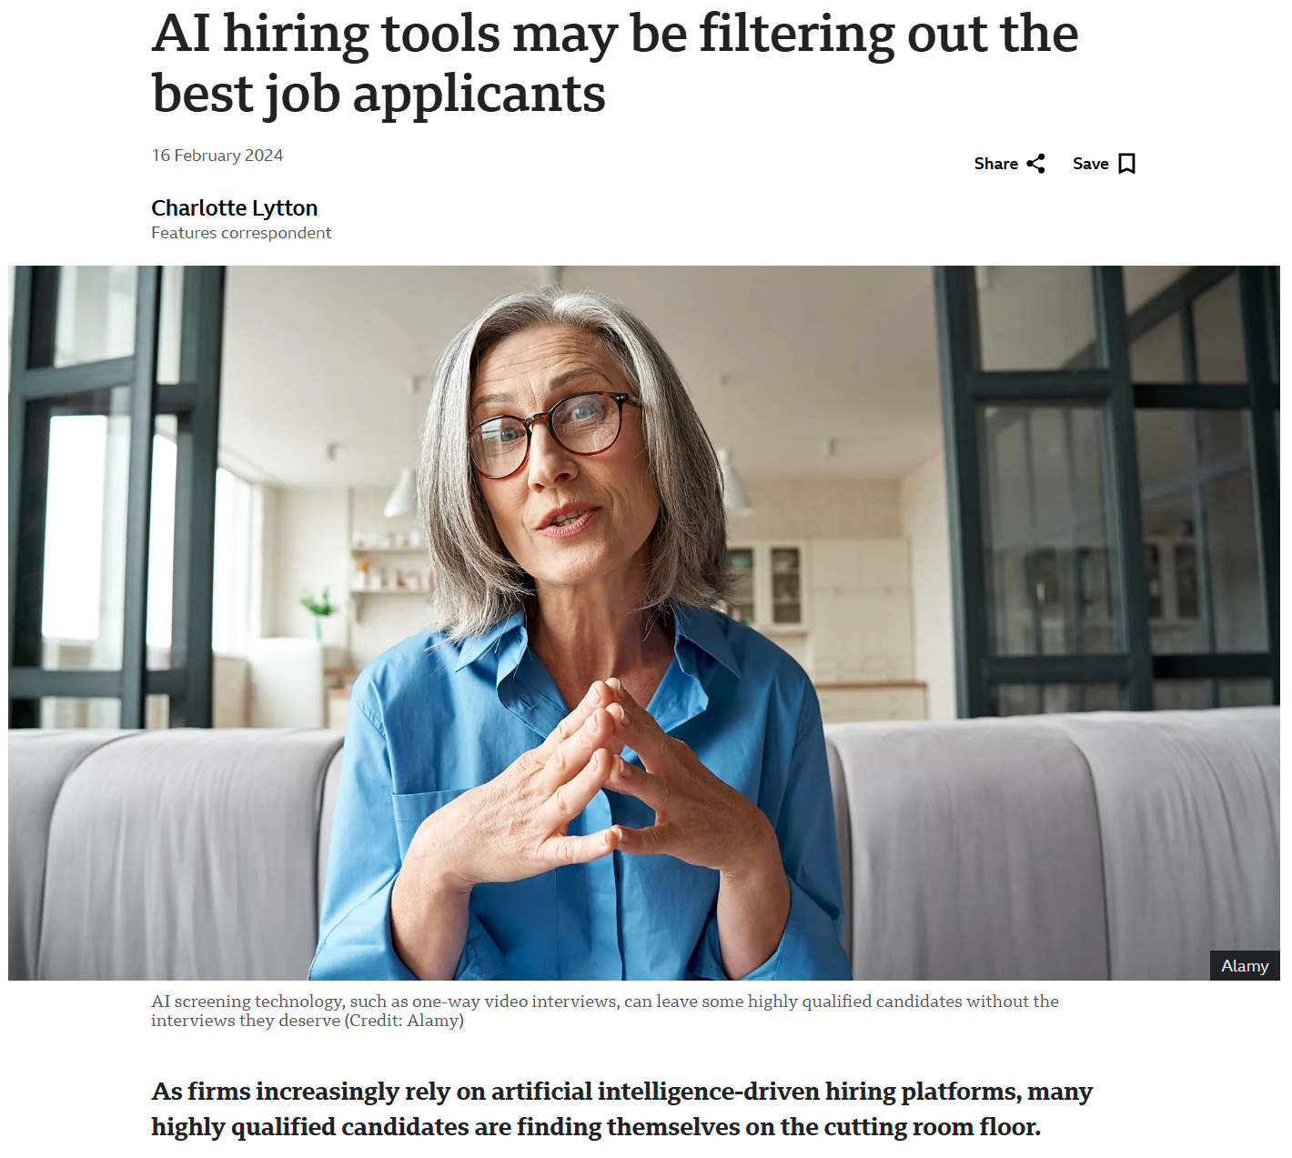
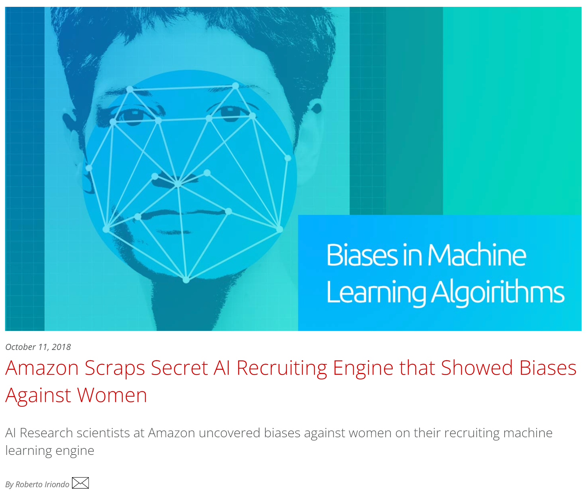
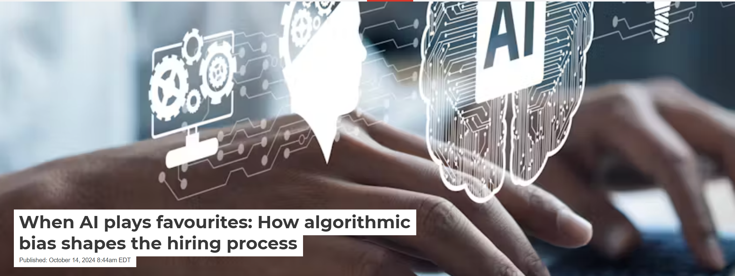
Introduction
Why Fairness Matters in Recruitment?
In recent years, with the widespread use of data-driven recruiting systems, there has been a growing interest in recruiting fairness in both academia and industry.
Machine learning has been widely used in recruitment, such as resume screening & salary prediction
Gender, salary bias in historical data may be amplified by algorithms
Unfairness in recruitment systems may affect business diversity
From Bias to Balance: A Data-Driven Approach to Fair Recruitment Practices

Slide 6
Introduction
Recently Existing Studies on Algorithmic Bias
Chandra et al. (2023) found that algorithms may inherit biases from historical data, leading to unfairness in the recruitment process.
Pessach & Shmueli (2022) noted that imbalance in training data and algorithm goal setting may affect the fairness of hiring predictions.
Quer et al. (2024) found that hiring scores may be biased against candidates younger than 25 years old. However, most studies still focus on overall bias and lack specific analysis on salary fairness and hiring scores.
There is a trade-off between accuracy and fairness, and as we strive for greater fairness, accuracy may be impacted (Pessach & Shmueli, 2022) .
Fabris et al. (2023) study notes that while many companies try to reduce bias in hiring algorithms, current technology is still unable to eliminate it completely.
From Bias to Balance: A Data-Driven Approach to Fair Recruitment Practices

Slide 7
Introduction
Recently Existing Studies on Algorithmic Bias
Machine Learning Recruitment Systems May Have Gender and Salary Bias
Data bias and model objectives may lead to unfair hiring decisions
Fairness constraints may reduce bias but impact prediction accuracy.
Existing research focuses on algorithmic bias and lacks in-depth analysis of salary and hiring scores.
From Bias to Balance: A Data-Driven Approach to Fair Recruitment Practices

Slide 8
Introduction
Research Questions
Bias in Data
Are gender, education, and job category distributions imbalanced in the dataset?
Do these factors significantly impact salary and hiring scores?
Bias in Algorithms
Do machine learning models amplify or inherit historical biases in the data?
Fairness Constraints (Future Research)
Can fairness modeling strategies be used to reduce gender bias in hiring systems?
What is the trade-off between fairness and prediction accuracy?
From Bias to Balance: A Data-Driven Approach to Fair Recruitment Practices

Slide 9
Introduction
Research Objectives
1. Quantifying Bias in Salary & Hiring Decisions
Analyze gender, education, and job category influences on salary and hiring scores.
Examine salary distribution across industries and education levels.
2. Investigating Salary Growth & Occupational Segregation
Assess how salary growth trends vary across genders and industries.
Explore the role of occupational segregation in salary discrepancies.
3. Provide data-driven recommendations for fair recruitment
Identify bias patterns in recruitment systems.
Propose algorithmic fairness methods for mitigating bias (future research).
From Bias to Balance: A Data-Driven Approach to Fair Recruitment Practices

Slide 10
Datasets & Date Preprocessing

Slide 11
Datasets Overview
Data Sources
This study uses three public datasets provided by UCI, GitHub, and ProPublica for analyze bias in the hiring process.
The data source and variable descriptions are as follows:
Datasets | Description | Data Sources
Adult Income | There are a total of 15 variables, including 48,842 records of personal income, age, gender, occupation, education, and other factors. Missing value shows ‘?’. | UCI Machine Learning Repository
Job Salary | 6,704 salary forecast data with 6 key variables, 17 records have missing values. | GitHub Repository
COMPAS | 60,843 recruitment scoring/risk prediction data, 28 variables. 45,240 records have missing values ​​(mostly MiddleName) | ProPublica GitHub
From Bias to Balance: A Data-Driven Approach to Fair Recruitment Practices

Slide 12
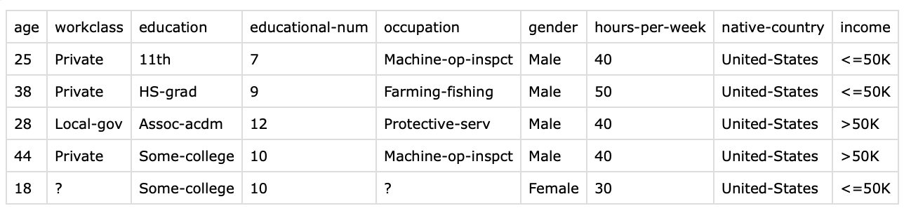
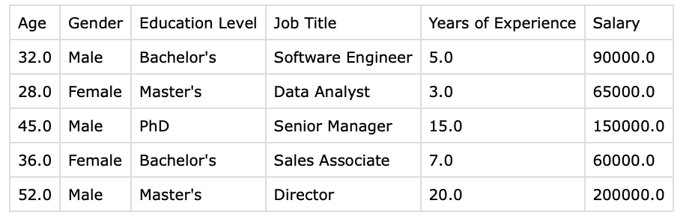
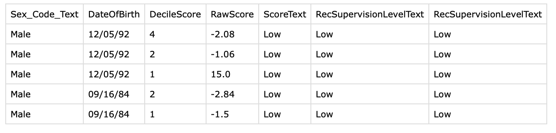
Datasets Overview
Key Variable Example: Adult Income
Key Variable Example: Job Salary
Key Variable Data Example: COMPAS
From Bias to Balance: A Data-Driven Approach to Fair Recruitment Practices

Slide 13
Data Preprocessing
Data Cleaning
Step 1: Handle Missing Values
Remove incomplete records less than 5%
Fill missing categorical data with mode imputation
Step 2: Convert Categorical Variables
Gender, Income → Binary encoding: Male (0), Female (1)
Job Categories, Workclass → Reclassification reducing category sparsity & One-Hot Encoding
Education → Ordinal
Step 3: Normalize Data
Winsorization handles abnormal data
Hiring scores normalization
Standardized salary & experience for consistency
Step 4: Unify all the variable name
Raw Data
Handling Missing Values
Categorical Encoding
Cleaned Dataset
Feature Scaling
From Bias to Balance: A Data-Driven Approach to Fair Recruitment Practices
Notes:
Adult Income datasetMissing value problem (some occupational categories are empty)
Category variables not standardized (workclass, education need to be converted to numeric values)
Job Salary datasetUnharmonized format of education and work experience (Bachelor's, BSc need to be harmonized)Salary ranges are too wide (abnormally high values)
COMPAS datasetRecruitment scoring values are anomalous (negative scoring)Extreme distribution of ratings for some candidates

Slide 14
Data Cleaning Results
Adult Income
42166 records
19 columns
Data type: int
No missing values
Job Salary
6684 records
15 columns
Data type: int
No missing values
COMPAS
60842 records
6 columns
Data type: int
No missing values
From Bias to Balance: A Data-Driven Approach to Fair Recruitment Practices
Notes:
Sex_Code_Text
Gender, core sensitive variable Renamed to Gender, converted to 0/1 variable
BOD
Age, a key factor affecting recruitment decisions Used directly, remove outliers (<16 or >65)
DecileScore
Fit score, originally represents risk score Mapped to Hiring_Score, adjust direction
RawScore
Raw score, used to fine-tune Hiring_Score Normalized as an auxiliary variable for bias analysis
ScoreText
Score category, can be used for decision grouping Redefined as recruitment fit high/medium/low
RecSupervisionLevel
Risk level, can be mapped to candidate category Renamed to Candidate_Risk_Level
RecSupervisionLevelText
Risk text classification, mapped to recruitment fit category Redefined as Candidate_Fit_Text

Slide 15
Data Preprocessing
Summary of Data Preparation
The final dataset has balanced categorical distributions.
Data cleaned, missing values addressed, categorical variables encoded, such as gender and job category variables.
Final dataset missing values handled, data standardized, and ready for bias analysis.
From Bias to Balance: A Data-Driven Approach to Fair Recruitment Practices

Slide 16
Methods

Slide 17
Statistical Analysis Methods
Bias in Data Analysis
Descriptive Statistics
Correlation Analysis
T-Test
Chi-Square
ANOVA
Regression Analysis
Ordinary Least Squares
Logistic Regression
Ordinal Logistic Regression
From Bias to Balance: A Data-Driven Approach to Fair Recruitment Practices

Slide 18
Methods
Fairness- Aware Modeling(Future Research)
Fairness Metrics
Fairness Optimization Methods
Future research will focus on the fairness evaluation.
Data level
Disparate Impact
Kolmogorov- Smirnov (KS) Test
Model level
Equal Opportunity
Equalized Odds
Future research will focus on the practical effects of fairness optimization. Three types of fairness optimization methods research program:
Data Preprocessing
Reweighting
Feature De-biasing
In – Processing
Fairness Regularization
Equalized Odds Contraints
Post- Processing
Output Calibration
Result Re-ranking
From Bias to Balance: A Data-Driven Approach to Fair Recruitment Practices

Slide 19
Key Findings

Slide 20
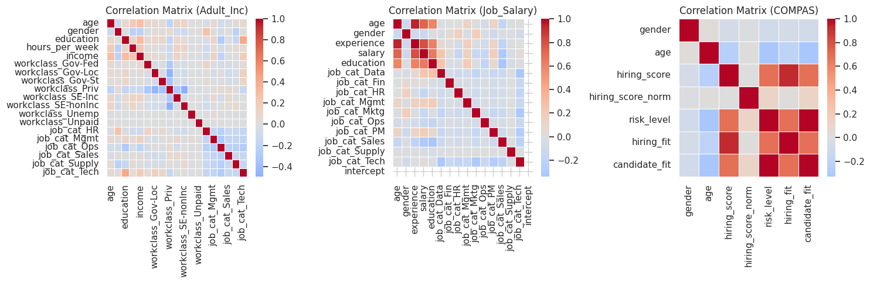
Key Findings
Bias in Data Analysis : Correlation Analysis
Adult_Inc:
Education appears to be a major factor influencing income, so salary models should account for it.
Gender does not show a strong direct effect, but further analysis is needed.
Job_Salary:
Experience is a stronger predictor of salary than education.
Job category has a significant influence on salary
COMPAS:
Potential bias in hiring scores against older candidates.
Hiring fit is heavily influenced by risk level.
From Bias to Balance: A Data-Driven Approach to Fair Recruitment Practices
Notes:
Salary is primarily influenced by experience and education, with gender having less of an impact
Hiring scores decrease with age and there are gender differences

Slide 21
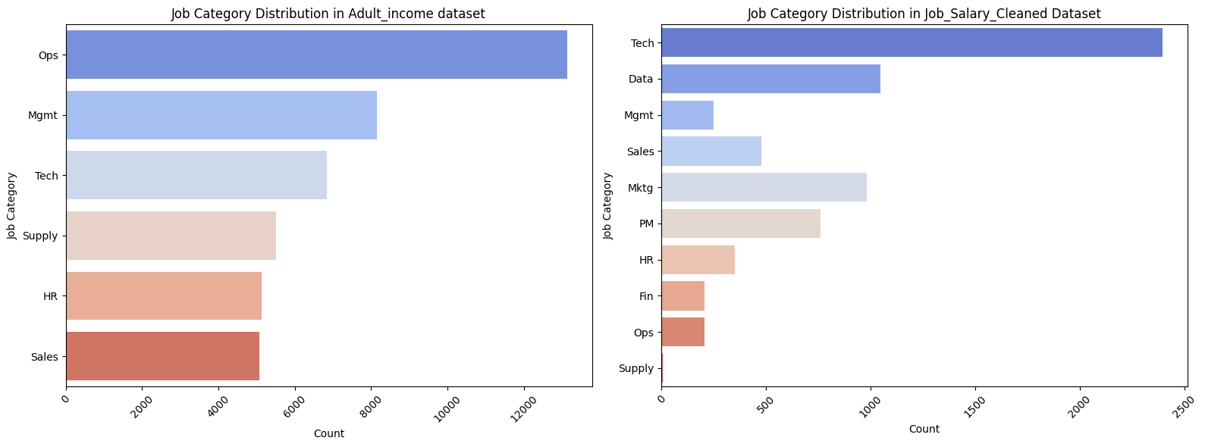
Key Findings
Bias in Data Analysis : Descriptive Statistics Analysis
Job Category Distribution
Adult_Income dataset: Operations & Administration (Ops) is the most common job category, followed by Marketing & Advertising (Mktg) and Tech & Engineering (Tech).
Job_Salary dataset: Tech is the most common category, followed by Data & Analytics (Data) and Mktg.
From Bias to Balance: A Data-Driven Approach to Fair Recruitment Practices
Notes:
Management & Executive (Mgmt)
Data & Analytics (Data)
Human Resources (HR)
Sales & Business Development (Sales)
Marketing & Advertising (Mktg)
Tech & Engineering (Tech)
Finance & Accounting (Fin)
Operations & Administration (Ops)
Project & Product Management (PM)
Supply Chain & Logistics (Supply)

Slide 22
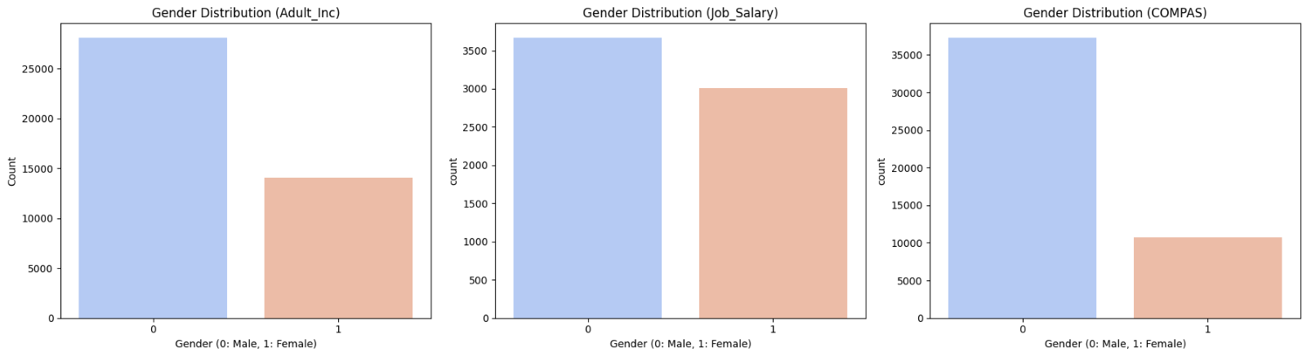
Key Findings
Bias in Data Analysis : Descriptive Statistics Analysis
Gender Distribution
Adult_Income & COMPAS dataset: The gender (0=Male, 1=Female) ratio is more unbalanced (higher for males).
Job_Salary dataset: The gender ratio is relatively balanced.
From Bias to Balance: A Data-Driven Approach to Fair Recruitment Practices

Slide 23
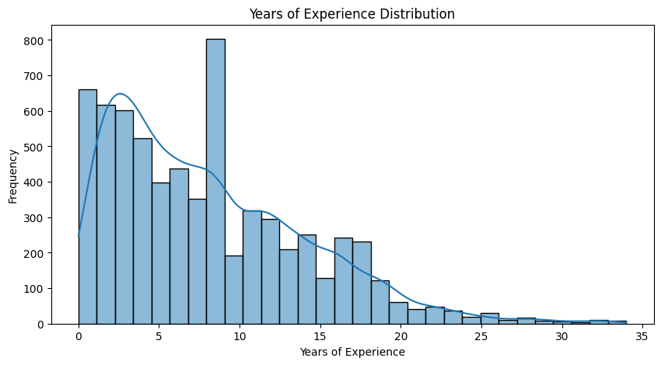
Key Findings
Bias in Data Analysis : Descriptive Statistics Analysis
Year of Experience Distribution
Job_Salary dataset: Right-skewed (positively skewed) distribution.
From Bias to Balance: A Data-Driven Approach to Fair Recruitment Practices
Notes:
1️⃣ Right-Skewed Distribution
The histogram shows a right-skewed (positively skewed) distribution, meaning most candidates have lower years of experience (0-10 years).
The number of individuals decreases as experience increases.
2️⃣ Two Peaks (Bimodal Distribution?)
There are two noticeable peaks:
First peak (~1-3 years): Likely represents entry-level candidates.
Second peak (~10 years): May represent mid-career professionals.
This suggests two dominant groups of candidates in the dataset.
3️⃣ Long Tail (>20 years)
There are some individuals with very high experience (25-35 years), but they are relatively few.
This long tail could indicate a small percentage of highly experienced professionals.
4️⃣ Data Imbalance
There are more early-career professionals compared to highly experienced ones.
If this dataset is used for hiring analysis, models may favor younger candidates unless adjusted properly.

Slide 24
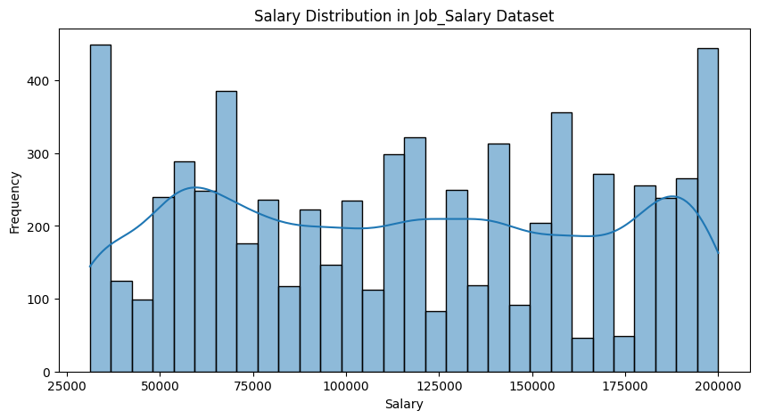
Key Findings
Bias in Data Analysis : Descriptive Statistics Analysis
Salary Distribution
Job_Salary dataset: Relatively scattered, with multiple peaks and large differences in salary levels.
From Bias to Balance: A Data-Driven Approach to Fair Recruitment Practices
Notes:
ANOVA: Compare whether the means of numerical variables are significantly different across multiple groups (≥2 groups) Continuous variables (numerical data)
e.g., salary, hiring scores Test for significant mean differences between categorical groups
Multiple Peaks
The salary distribution is not normally distributed; instead, it has multiple peaks, suggesting that there are distinct salary groups.
Possible reasons:
Different salary bands for entry-level, mid-level, and senior positions.
Salary differences across industries, job roles, or locations.
Unlike a right-skewed distribution where most values are on the lower end, this dataset has salaries fairly distributed across the range.
However, variability is high, which means salary disparities exist.

Slide 25
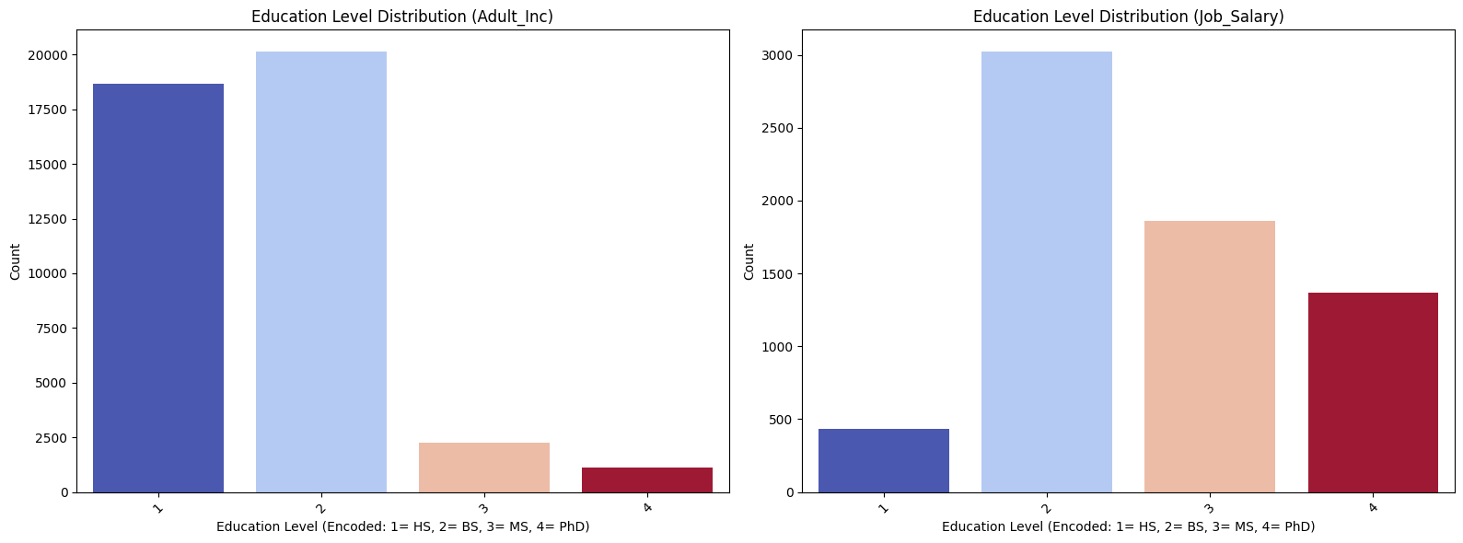
Key Findings
Bias in Data Analysis : Descriptive Statistics Analysis/ ANOVA
Education Level Distribution
Adult_Income dataset: The educational background is mainly high school (HS) and bachelor's degree (BS).
Job_Salary dataset:
BS is the largest, while the proportion of master's degree (MS) and doctorate (PhD) is relatively high.
F-statistic > 1,000 → Large F-value, indicating strong between-group variance.
p-value < 0.01, education level significantly affects salary.
From Bias to Balance: A Data-Driven Approach to Fair Recruitment Practices
Notes:
To find which education levels differ significantly, run Tukey’s HSD (Honest Significant Difference) test
This will tell us exactly which education levels have significant salary differences.

Slide 26
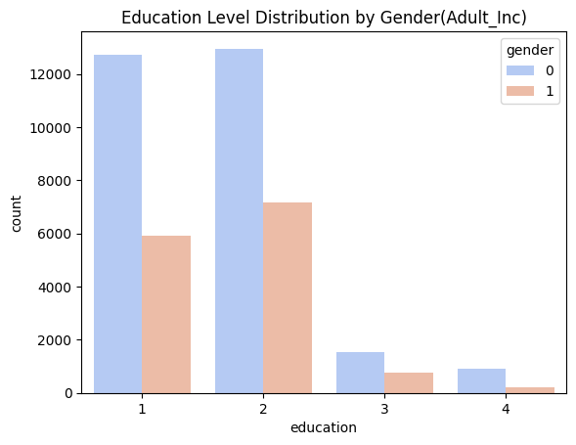
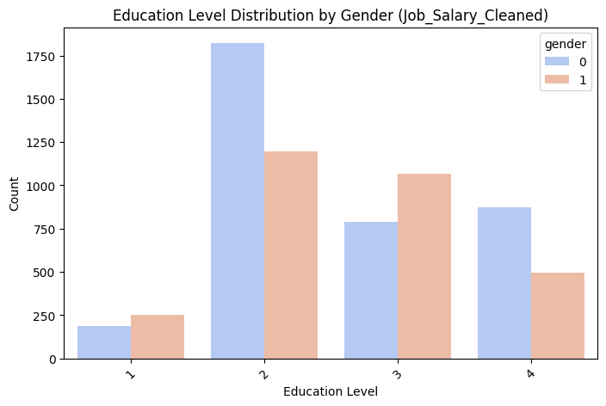
Key Findings
Bias in Data Analysis : Descriptive Statistics Analysis
Education Distribution by Gender
Adult_Income dataset: Male (0) dominate all education levels, especially at lower levels. Few individuals, regardless of gender, have the highest education levels (PhD).
Job_Salary dataset: Female have higher representation in BS and MS In contrast to Adult_Inc, the gender gap in Master’s and PhD degrees is smaller, possibly due to dataset selection.
From Bias to Balance: A Data-Driven Approach to Fair Recruitment Practices

Slide 27
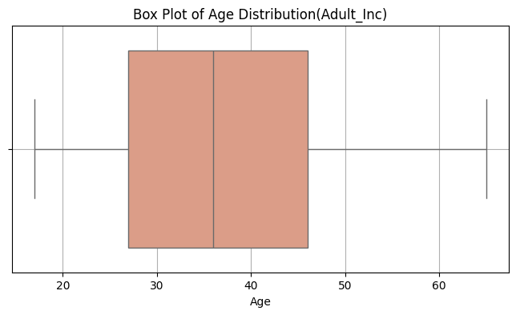
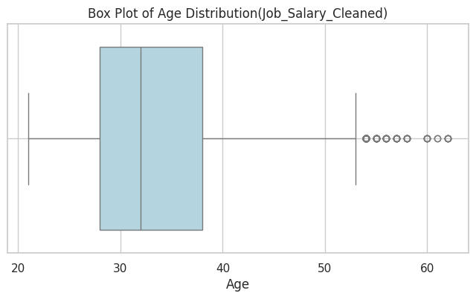
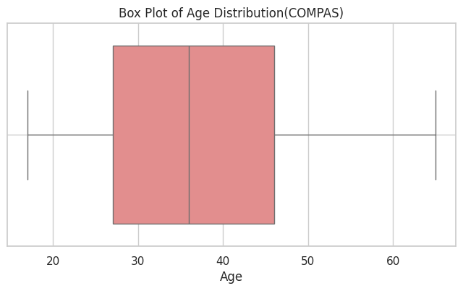
Key Findings
Bias in Data Analysis : Descriptive Statistics Analysis
Age Distribution
Adult_Inc & COMPAS dataset : Similar age distributions.
Job_Salary dataset: younger workforce with some outlier.
From Bias to Balance: A Data-Driven Approach to Fair Recruitment Practices
Notes:
✅ Adult_Inc Dataset
Median Age: Around 35-40 years old, similar to COMPAS.
IQR: ~25 to 45 years old, also similar to COMPAS.
Min & Max: Extends from ~18 to 65 years old.
No strong outliers, meaning age is evenly distributed.
Looks very similar to COMPAS, suggesting both datasets have broad age coverage.
✅ Job_Salary_Cleaned Dataset
Median Age: Slightly lower (~30-35 years old) compared to COMPAS and Adult_Inc.
IQR: ~25 to 40 years old.
Noticeable Outliers:
Outliers appear above 50-55 years old, indicating a small number of older individuals with high ages.
Possible age-based bias in the dataset (fewer senior professionals included).
✅COMPAS Dataset
Median Age: Around 35-40 years old.
IQR (Interquartile Range, 25th to 75th percentile): ~25 to 45 years old.
Minimum & Maximum: Appears to range from ~18 to ~65 years old.
No extreme outliers visible.
Balanced distribution, covering a wide range of ages.

Slide 28
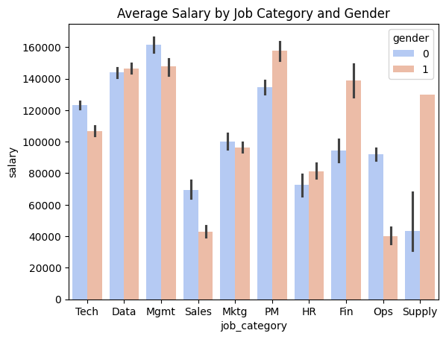
Key Findings
Bias in Data Analysis : Descriptive Statistics Analysis/T - Test
Salary Distribution by Gender
1. Gender Pay Gap Varies by Job Category
Tech, Data, Mgmt, and Project & Product Management (PM) :
Female salaries closely match or exceed male salaries.
PM is the only category where women earn more on average than men.
2. Male Salaries Are More Dispersed, With Higher Peaks
Male have a wider salary distribution, more high-earning.
Female salaries are more concentrated, fewer reach top salaries .
3. Significant Male Salary Advantage in Certain Fields
Sales & Business Development (Sales), Ops, and Supply Chain & Logistics (Supply) :
Male salaries are significantly higher than female salaries.
This could indicate occupational segregation, where male dominate leadership roles.
4. Female Salary Advantage in Finance & HR
Fin and HR :
Female earn more on average than male.
These fields tend to have higher female representation, which may contribute to this trend.
T-Test (p-value < 0.001)
From Bias to Balance: A Data-Driven Approach to Fair Recruitment Practices
Notes:
Management & Executive (Mgmt)
Data & Analytics (Data)
Human Resources (HR)
Sales & Business Development (Sales)
Marketing & Advertising (Mktg)
Tech & Engineering (Tech)
Finance & Accounting (Fin)
Operations & Administration (Ops)
Project & Product Management (PM)
Supply Chain & Logistics (Supply)

Slide 29
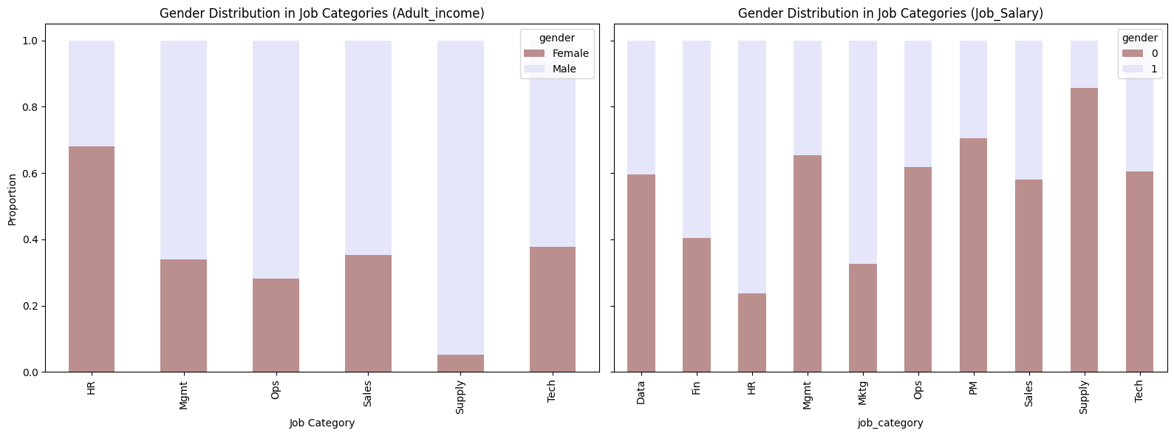
Key Findings
Bias in Data Analysis : Descriptive Statistics Analysis
Job Category by Gender
Adult_Income Dataset: Human Resources(HR) has the highest proportion of females (~65%). Supply Chain & Logistics (Supply) is male-dominated (~90% male).
Job_Salary Dataset: The gender distribution is more even.
Tech and Supply Are Strongly Male-Dominated
HR and Finance & Accounting (Fin) Have More Female Representation
From Bias to Balance: A Data-Driven Approach to Fair Recruitment Practices
Notes:
There is significant Occupational Segregation in the gender distribution:
✅ Adult_Income Dataset (Left Chart)
Finance & Accounting (Fin)
HR (Human Resources) has the highest proportion of females (~65%).
Management (Mgmt) and Sales have a moderate female representation (~30-40%).
Operations, Supply Chain, and Tech are male-dominated (~90% male).
✅ Job_Salary Dataset (Right Chart)
HR has a lower female proportion (~35%) than in Adult_Income, indicating male participation in HR roles.
Finance & Marketing have a more balanced distribution (~40-50% females).
Tech and Supply Chain remain male-dominated (~90% male).
Sales & Operations have a much higher female proportion in Job_Salary compared to Adult_Income.

Slide 30
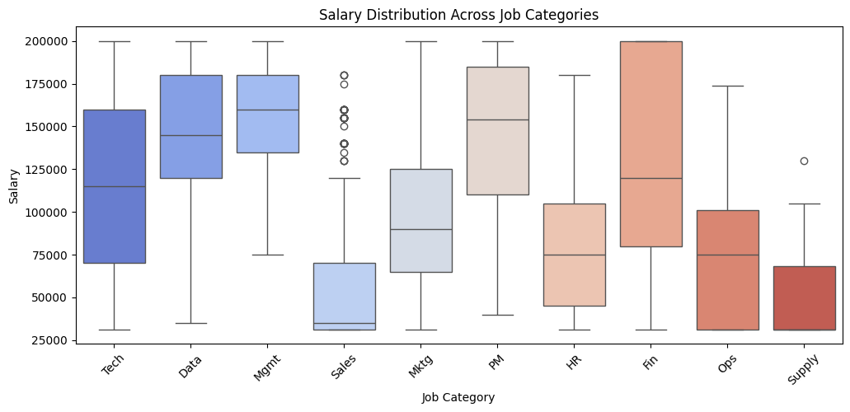
Key Findings
Bias in Data Analysis : Descriptive Statistics Analysis/ANOVA
Job Category by Gender
Job_Salary Dataset:
F-statistic > 250 → Large F-value, at least one job category has a significantly different salary distribution
p-value < 0.01, job categories significantly impact salary levels.
From Bias to Balance: A Data-Driven Approach to Fair Recruitment Practices
Notes:
There is significant Occupational Segregation in the gender distribution:
✅ Adult_Income Dataset (Left Chart)
Finance & Accounting (Fin)
HR (Human Resources) has the highest proportion of females (~65%).
Management (Mgmt) and Sales have a moderate female representation (~30-40%).
Operations, Supply Chain, and Tech are male-dominated (~90% male).
✅ Job_Salary Dataset (Right Chart)
HR has a lower female proportion (~35%) than in Adult_Income, indicating male participation in HR roles.
Finance & Marketing have a more balanced distribution (~40-50% females).
Tech and Supply Chain remain male-dominated (~90% male).
Sales & Operations have a much higher female proportion in Job_Salary compared to Adult_Income.

Slide 31
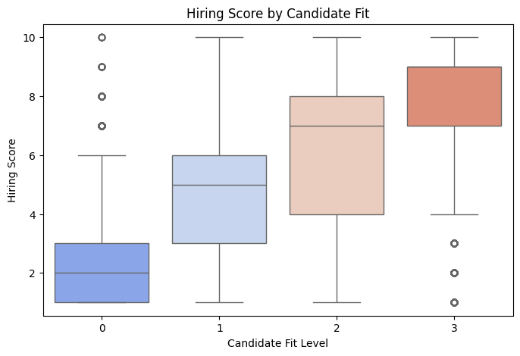
Key Findings
Bias in Data Analysis : Descriptive Statistics Analysis/ ANOVA
Hiring Score Differences Across Risk Levels
COMPAS dataset:
F-statistic > 1,4000 → Large F-value, indicating strong between-group variance.
p-value < 0.01, hiring scores differ significantly across different risk levels.
This suggests that higher-risk candidates may receive systematically lower hiring scores.
From Bias to Balance: A Data-Driven Approach to Fair Recruitment Practices
Notes:
Post-hoc Testing Tukey HSD Results: Hiring scores are significantly different across all risk levels.
Higher-risk candidates consistently receive lower hiring scores.

Slide 32
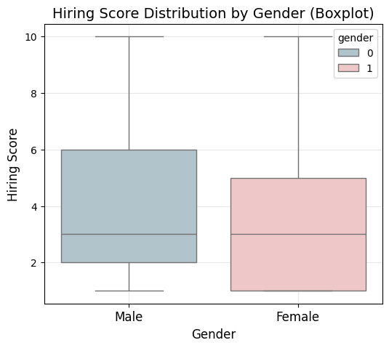
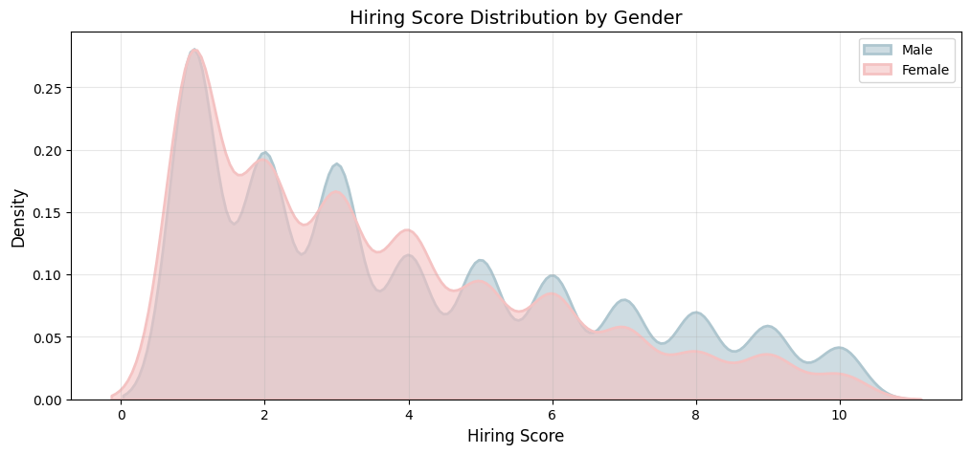
Key Findings
Bias in Data Analysis : Descriptive Statistics Analysis/T - Test
Hiring Scores vs. Gender Analysis
COMPAS dataset:
Blue (male) and pink (female) represent the probability density distribution of recruitment scores for both sexes. This shows that males have a higher overall performance in recruitment scores.
Although the median score for female is slightly higher, the proportion of high scores is smaller, while the proportion of high scores for male is larger.
T- Test: P-value < 0.001, there are significant differences in recruitment scores by gender.
From Bias to Balance: A Data-Driven Approach to Fair Recruitment Practices
Notes:
KDE Plot: Overall, the distribution density of males is higher in the higher recruitment scores (above 5 points), while the recruitment scores of females are mainly concentrated in the lower scores (0-3 points).

Slide 33
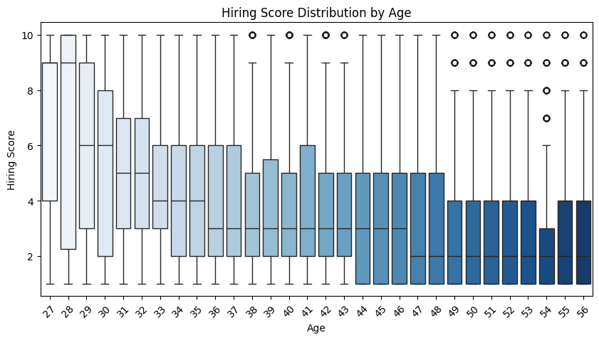
Key Findings
Bias in Data Analysis : Descriptive Statistics Analysis
Age vs. Hiring Score
COMPAS dataset:
Younger candidates have a wider distribution of hiring scores, while older candidates have more concentrated scores.
Lower scoring age groups (over 30) are more stable than younger people
From Bias to Balance: A Data-Driven Approach to Fair Recruitment Practices
Notes:
KDE Plot: Overall, the distribution density of males is higher in the higher recruitment scores (above 5 points), while the recruitment scores of females are mainly concentrated in the lower scores (0-3 points).

Slide 34
Bias Analysis

Slide 35
Key Findings
Analysis of Sources of Bias: Ordinary Least Squares(Ols) Model
Gender vs. Salary bias
Job_category dataset:
Model 1: Use of gender only to predict salary
Salary ~ gender, P<0.001, R² < 0.02.
Gender has a significant effect on salary, but R² is extremely low ability to explain salary changes by gender variables
Model 2: Control of education and experience
Salary ~ gender + education + experience, P<0.001, R² > 0.06.
Gender still has a significant impact on salaries, but education and experience can partially reduce the gap. Education and experience are the main salary determinants.
Model 3: Controlling for education, experience and job_category
salary ~ gender + education + experience + job_category, P> 0.05, R² > 0.07.
The effect of gender on salary is no longer significant after controlling for job category.
This suggests that the gender salary gap arises mainly from differences in job categories rather than gender.
From Bias to Balance: A Data-Driven Approach to Fair Recruitment Practices

Slide 36
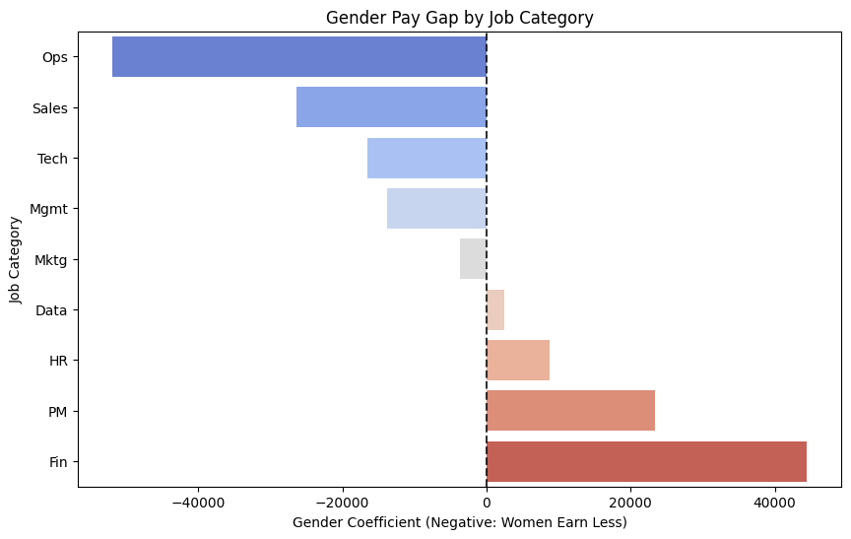
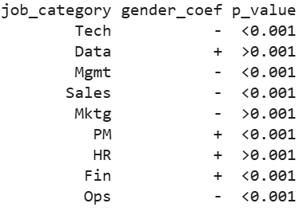
Key Findings
Analysis of Sources of Bias: Ordinary Least Squares(OLS) Regression Model
Gender salary differentials in Job Category
Job_category dataset:
Bar Plot : The salary difference associated with gender.
Negative values (blue bars) indicate female earn less than male. Positive values (red bars) indicate female earn more than male.
OSL Model: salary ~ gender for each industry, grouped by job_category.
Females face the largest salary gaps in Ops, Sales, and Tech.
Mktg and Data show no significant pay gap.
Fin and PM favor women, with significantly higher salaries for them.
From Bias to Balance: A Data-Driven Approach to Fair Recruitment Practices

Slide 37
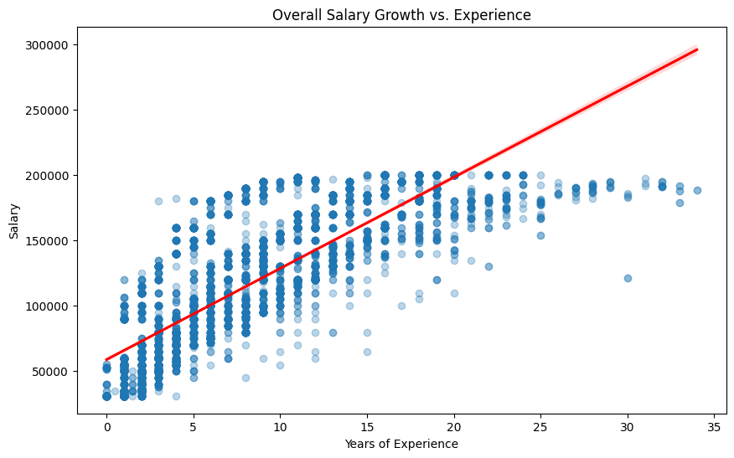
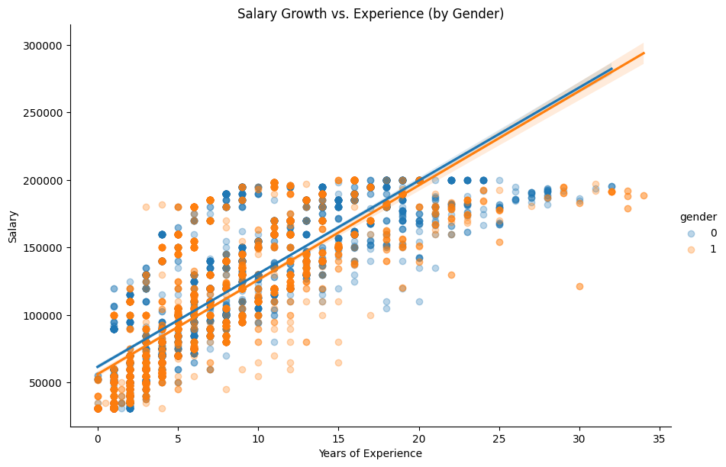
Key Findings
Analysis of Sources of Bias: Ordinary Least Squares(OLS) Regression Model
Job_category dataset:
Overall Salary vs. Experience : Salary growth is linear, with higher experience leading to higher salaries, but salary growth slows down after 20 years.
Salary growth by gender: Experience strongly impacts salary for both of them. Female (orange) and Male (blue) salary growth curves are similar but start at different points (lower for females)
OSL Regression: The salary gap is persistent and could be due to other factors, such as job category or promotions.
Model 1: salary ~ experience, P<0.001, R² > 0.06. Suggests that the effect of experience on salary is highly significant.
Model 2: salary(gender = male) ~ experience, P<0.001, R² > 0.06.
Model 3: salary(gender = female) ~ experience, P<0.001, R² > 0.06.
Salary Growth vs. Year of Experience
From Bias to Balance: A Data-Driven Approach to Fair Recruitment Practices

Slide 38
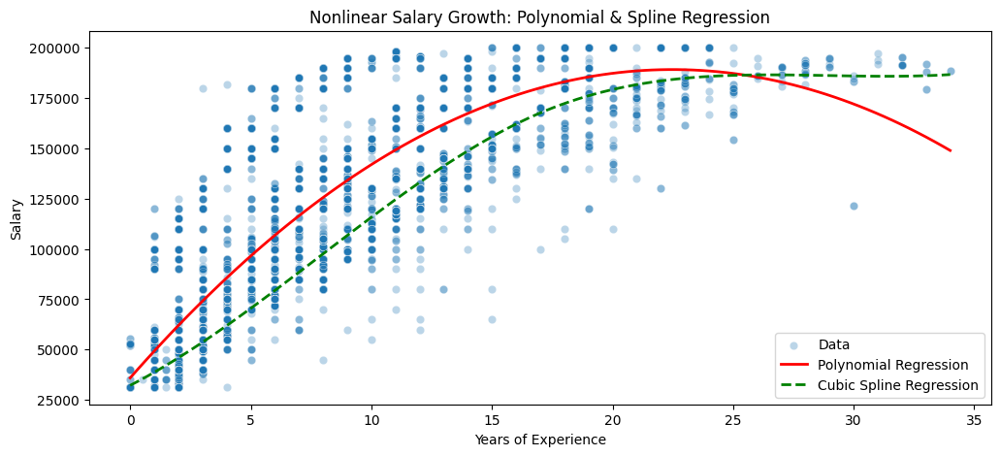
Key Findings
Analysis of Sources of Bias: Polynomial Regression Model
Non-linear Trends in Salary Increases
Job_category dataset:
Polynomial Regression to analyze the effect of experience² on salary growth.
Cubic Spline to get a smoother nonlinear trend.
Polynomial Regression Model : Salary ~ Experience + Experience^2, P<0.001, R² > 0.07. Suggests that the effect of experience on salary is highly significant.
Experience Early stage (0-10 years): Salary growth is rapid and the curve is steep.
Experience Mid-term (10-20 years): Salary growth slows down and the growth rate decreases.
Experience Late stage (20+ years): Salary growth tends to be stable or even slightly declines.
From Bias to Balance: A Data-Driven Approach to Fair Recruitment Practices

Slide 39
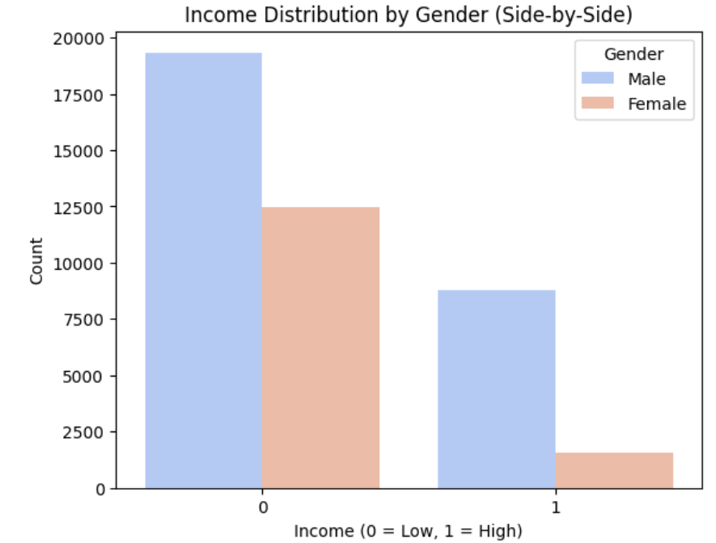
Key Findings
Analysis of sources of bias: Logistic Regression Model
Gender vs. Income
Adult_ income dataset:
Logistic Regression Model：
income ~ gender
The gender coefficient is negative and highly significant (p < 0.001), indicating that women are less likely to earn a high income compared to men.
Odds Ratio around 0.3, female are about 70% less likely to earn a high income compared to mael.
From Bias to Balance: A Data-Driven Approach to Fair Recruitment Practices

Slide 40
Key Findings
Analysis of Sources of Bias: Logistic Regression Model
The Impact of Education vs. Gender on Income
Adult_ income dataset:
Logistic Regression Model：
income ~ gender + education
The negative effect is still significant (p < 0.001), indicating that even after controlling for education level, it is still more difficult for women to earn high income than men.
Higher education significantly increases the probability of earning a high income (OR > 2.5). Education explains part of the income gap, but not all of it.
From Bias to Balance: A Data-Driven Approach to Fair Recruitment Practices

Slide 41
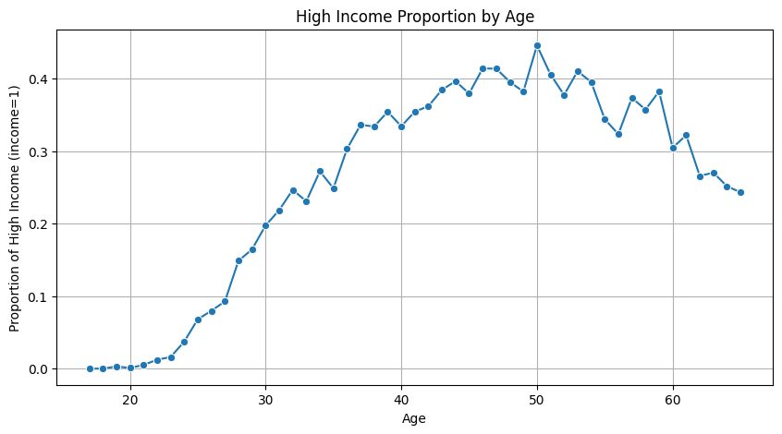
Key Findings
Analysis of Sources of Bias: Logistic Regression Model
Age vs. Income Analysis
Adult_ income dataset:
Logistic Regression Model: Analyze the relationship between age and high income (income=1)
Model 1: Income(income=1) ~ age , p < 0.001, Age is significantly positively correlated with high income
Model 2: Income(income=1) ~ age + gender, p < 0.001, After controlling for age, gender still significantly affects income, and women are significantly less likely to enter the high-income group than men.
From Bias to Balance: A Data-Driven Approach to Fair Recruitment Practices

Slide 42
Key Findings
Analysis of Sources of Bias: Ordinal Logistic Regression
Hiring Scores vs. Gender, Age, Hiring_fit, Candidate_fit
COMPAS dataset:
Ordinal Logistic Regression Model: Hiring Scores ~ Gender + Age + Hiring_fit + Candidate_fit
gender, p<0.05
age, p<0.001, the older the age, the lower the recruitment score.
hiring_fit, p<0.001, indicating that candidates with high recruitment fit are more likely to receive higher scores
candidate_fit, p<0.001, also has a significant impact on the recruitment score.
The recruitment score is most affected by hiring_fit and candidate_fit.
Older candidates have significantly lower scores than younger ones
From Bias to Balance: A Data-Driven Approach to Fair Recruitment Practices
Notes:
OLS is not suitable for the study of ordered variables

Slide 43
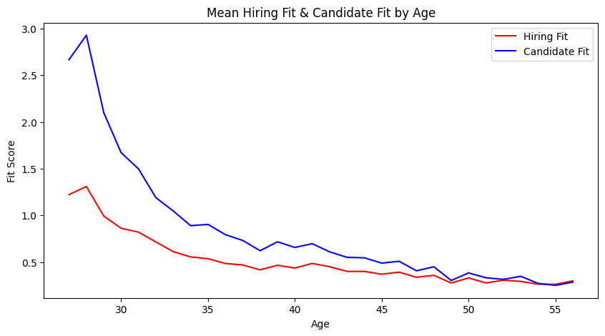
Key Findings
Analysis of Sources of Bias: Ordinal Logistic Regression
Hiring Scores vs. Gender, Age, Hiring_fit, Candidate_fit
COMPAS dataset:
Model1 : hiring_fit ~ age
Age was significantly and negatively related to fitness for recruitment, p < 0.001
Model2 : candidate_fit ~ age
p < 0.001, age has a stronger negative effect on candidate fit than recruitment fit
From Bias to Balance: A Data-Driven Approach to Fair Recruitment Practices
Notes:
OLS is not suitable for the study of ordered variables

Slide 44
Conclusion

Slide 45
From Bias to Balance: A Data-Driven Approach to Fair Recruitment Practices
Contributions
Empirical Bias Analysis, study quantifying salary bias across multiple datasets, and analyzing gender salary gaps
Hiring Score Evaluation evaluated hiring score biases, identifying potential inconsistencies in AI-driven recruitment models
Career Growth Modeling, understanding long-term salary trends, offering to track salary progression disparities over time.
Beyond academic contributions, our findings hold practical implications for industry professionals, policymakers, and AI developers.

Slide 46
From Bias to Balance: A Data-Driven Approach to Fair Recruitment Practices
Further Analysis
Current research mainly measures gender bias in salary and recruitment scores, but has not yet achieved a comprehensive fairness assessment.
Use fairness measurement methods (Equalized Odds and Disparate Impact) to further verify whether the model has discriminatory predictions.
Use Fairness optimization strategies (Reweighting)
Optimizing Algorithmic Fairness (Data Augmentation)
Comparison of the effectiveness of different fairness optimization methods

Slide 47
From Bias to Balance: A Data-Driven Approach to Fair Recruitment Practices
Limitations
This study reveals gender bias in salary and hiring scores, but the following limitations remain.
Limitations at the data level: the publicly available dataset (Adult_Inc, Job_Salary, COMPAS) used in this study may not fully reflect the fairness of the actual hiring market.
Limitations of the statistical analysis: it was not possible to fully control for all variables affecting salary.
Model fairness modeling is not yet complete, and this study has not yet implemented fairness optimization on a machine learning model

Slide 48
Thank You For Listening!
From Bias to Balance: A Data-Driven Approach to Fair Recruitment Practices
Hairu Fan, Department of Statistics, Actuarial and Data Sciences, CMU
Email: fan2h@cmich.edu

